Slide 1
Arithmetic Functions

Slide 2
Iterative Arrays
Example: n = 32
Number of inputs = ?
Truth table rows = ?
Equations with up to ? input variables
Equations with huge number of terms
Design impractical!
Iterative array takes advantage of the regularity to make design feasible
Notes:
Number of Inputs = 66
Truth Table Rows = 2⁶⁶
Equations with up to 66 variables

Slide 3
Half Adder (1-bit)
A
B
A | B | S(um) | C(arry)
0 | 0 | 0 | 0
0 | 1 | 1 | 0
1 | 0 | 1 | 0
1 | 1 | 0 | 1
S
B
C
B
Half
Adder
1
0
1
0
1
A
1
A
1
2
3
2
3
C
S
A
Sum
B
Carry

Slide 4
Full Adder
A
B
Cin | A | B | S(um) | Cout
0 | 0 | 0 | 0 | 0
0 | 0 | 1 | 1 | 0
0 | 1 | 0 | 1 | 0
0 | 1 | 1 | 0 | 1
1 | 0 | 0 | 1 | 0
1 | 0 | 1 | 0 | 1
1 | 1 | 0 | 0 | 1
1 | 1 | 1 | 1 | 1
Full
Adder
Carry In
(Cin)
Carry Out
(Cout)
S
AB
Cin
 | 00 | 01 | 11 | 10
0 | 0 | 1 | 0 | 1
1 | 1 | 0 | 1 | 0
AB
Cin
 | 00 | 01 | 11 | 10
0 | 0 | 0 | 1 | 0
1 | 0 | 1 | 1 | 1

Slide 5
Full Adder
H.A.
H.A.
A
S
A
S
B
A
S
A
S
Cin
Half
Adder
Half
Adder
B
B
C
B
C
Cout
Cout
Cin

Slide 6
4-bit Ripple Adder using Full Adder
A3
B3
A2
B2
A1
B1
A0
B0
A
B
A
B
A
B
A
B
Carry
Full
Adder
Full
Adder
Full
Adder
Full
Adder
Cout
Cin
Cout
Cin
Cout
Cin
Cout
Cin
S
S
S
S
S3
S2
S1
S0
A
S
A
S
H.A.
H.A.
B
Cout
B
C
Cin
Full Adder
Half Adder

Slide 7
Half Subtractor(1-bit)
A
B
A | B | Difference (D) | Borrow (B)
0 | 0 | 0 | 0
0 | 1 | 1 | 1
1 | 0 | 1 | 0
1 | 1 | 0 | 0
Half
Subtractor
Borrow
Diff
A
Diff
B
Borrow

Slide 8
Full Subtractor
A
B
Borrow (in) | A | B | Difference (D) | Borrow (out)
0 | 0 | 0 | 0 | 0
0 | 0 | 1 | 1 | 0
0 | 1 | 0 | 1 | 0
0 | 1 | 1 | 0 | 1
1 | 0 | 0 | 1 | 0
1 | 0 | 1 | 0 | 1
1 | 1 | 0 | 0 | 1
1 | 1 | 1 | 1 | 1
Full
Subtractor
Borrow In
(Bin)
BorrowOut
(Bout)
Difference

Slide 9
4-bit Ripple Subtractor using Full Subtractor
A3
B3
A2
B2
A1
B1
A0
B0
A
B
A
B
A
B
A
B
Borrow
Full
Subtractor
Full
Subtractor
Full
Subtractor
Full
Subtractor
Bout
Bin
Bout
Bin
Bout
Bin
Bout
Bin
D
D
D
D
D3
D2
D1
D0

Slide 10
Binary 1's Complement
For r = 2, N = 01110011₂, n = 8 (8 digits):
(r^{n} – 1) = 256 -1 = 255₁₀ or 11111111₂
The 1's complement of 01110011₂ is then:
11111111
– 01110011
10001100
Since the 2^{n} – 1 factor consists of all 1's and since 1 – 0 = 1 and 1 – 1 = 0, the one's complement is obtained by complementing each individual bit (bitwise NOT).

Slide 11
Binary 2's Complement
For r = 2, N = 01110011₂, n = 8 (8 digits), we have:
(r^{n} ) = 256₁₀ or 100000000₂
The 2's complement of 01110011 is then:
100000000 – 01110011 10001101
Note the result is the 1's complement plus 1, a fact that can be used in designing hardware

Slide 12
Adder/Subtractor Design
01010100 01010100
– 01000011 + 10111101
00010001
The carry of 1 indicates that no correction of the result is required.
01000011 01000011
– 01010100 + 10101100
11101111
00010001
The carry of 0 indicates that a correction of the result is required.
Result = – (00010001)

Slide 13
Adder/Subtractor Design
Subtract
B3
B2
B1
B0
A3
A2
A1
A0
A
B
A
B
A
B
A
B
C
Full
Adder
Full
Adder
Full
Adder
Full
Adder
Cout
Cin
Cout
Cin
Cout
Cin
Cout
Cin
S
S
S
S
S3
S2
S1
S0
A – B = A + (-B)
Take 2’s complement of B
Perform addition of A and 2’s complement of B

Slide 14
Overflow/Underflow
What is largest positive number represented by 8-bit?
What is smallest negative number represented by 8-bit?
8-bit Signed number addition
8-bit Signed number addition
01001000 (+72)
00111001 (+57)
+__________
(+129)
10000001 (-127)
11111010 (-6)
-_____________
(-133)
Cn-1 = 1
Cn = 0
Cn-1 = 0
Cn = 1

Slide 15
Overflow/Underflow Detection
C_{n-1} | A_{n-1} | B_{n-1} | S_{n-1} | C_{n} | OF
0 | 0 | 0 | 0 | 0
0 | 0 | 1 | 1 | 0
0 | 1 | 0 | 1 | 0
0 | 1 | 1 | 0 | 1
1 | 0 | 0 | 1 | 0
1 | 0 | 1 | 0 | 1
1 | 1 | 0 | 0 | 1
1 | 1 | 1 | 1 | 1
Examine the MSB bit
Bottom line:
P: positive; N: negative
N + N = N
P + P = P
P+N or N+P always fall into the range
E.g. -128+P cannot be smaller than -128 or bigger than 127
Problem lies in
N+N = P
P+P = N
Discarded

Slide 16
Overflow/Underflow Detection
C_{n-1} | A_{n-1} | B_{n-1} | S_{n-1} | C_{n} | OF
0 | 0 | 0 | 0 | 0 | 0
0 | 0 | 1 | 1 | 0 | 0
0 | 1 | 0 | 1 | 0 | 0
0 | 1 | 1 | 0 | 1 | 1
1 | 0 | 0 | 1 | 0 | 1
1 | 0 | 1 | 0 | 1 | 0
1 | 1 | 0 | 0 | 1 | 0
1 | 1 | 1 | 1 | 1 | 0
Discarded

Slide 17
Overflow/Underflow Detection
A3
B3
A2
B2
A1
B1
A0
B0
Carry
A
B
A
B
A
B
A
B
Cout
Cin
Cout
Cin
Cout
Cin
Cout
Cin
S
S
S
S
S3
S2
S1
S0
Overflow/
Underflow
n-bit Adder/Subtractor
Cn
Overflow/
Underflow
Cn-1

Slide 18
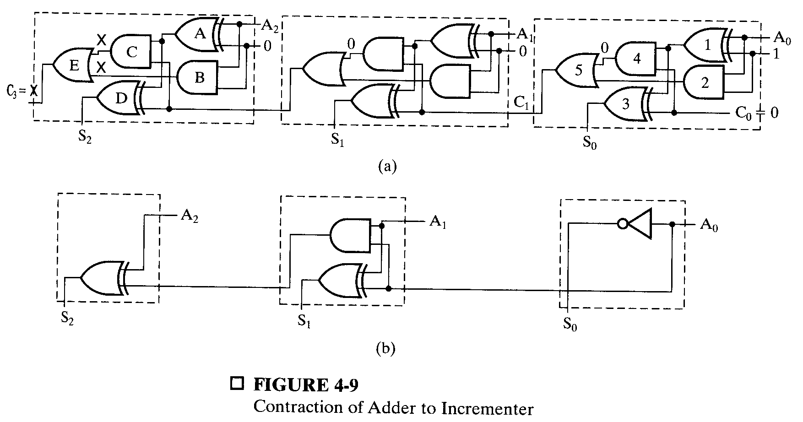
Design by Contraction
Contraction is a technique for simplifying the logic in a functional block to implement a different function
Contraction of a ripple carry adder to incrementer for n = 3
Set B = 001

Slide 19
Unsigned Integer Multiplier (2-bit)
b1
a1
b1
a0
b0
a1
b0
a0
H.A.
H.A.
c
c
s
s
s
carry out
carry
p3
p2
p1
p0

Slide 20
Unsigned Integer Multiplier (3-bit)
b1
a2
b1
a1
b0
a2
b1
a0
b0
a1
b0
a0
0
F.A.
F.A.
F.A.
0
co
ci
co
ci
co
ci
s
s
s
s
s
s
b2
a2
b2
a1
b2
a0
c
c
c
s
F.A.
F.A.
F.A.
s
s
0
0
co
ci
co
ci
co
ci
c
s
c
s
c
s
p5
p4
p3
p2
p1
p0

Slide 21
Multiplication by a Constant
Multiplication of B(3:0) by 101
B
B
B
B
0
0
B
B
B
B
3
2
1
0
3
2
1
0
4-bit Adder
Carry
output
Sum
C
6
C
5
C
4
C
3
C
2
C
1
C
0

